Slide 1
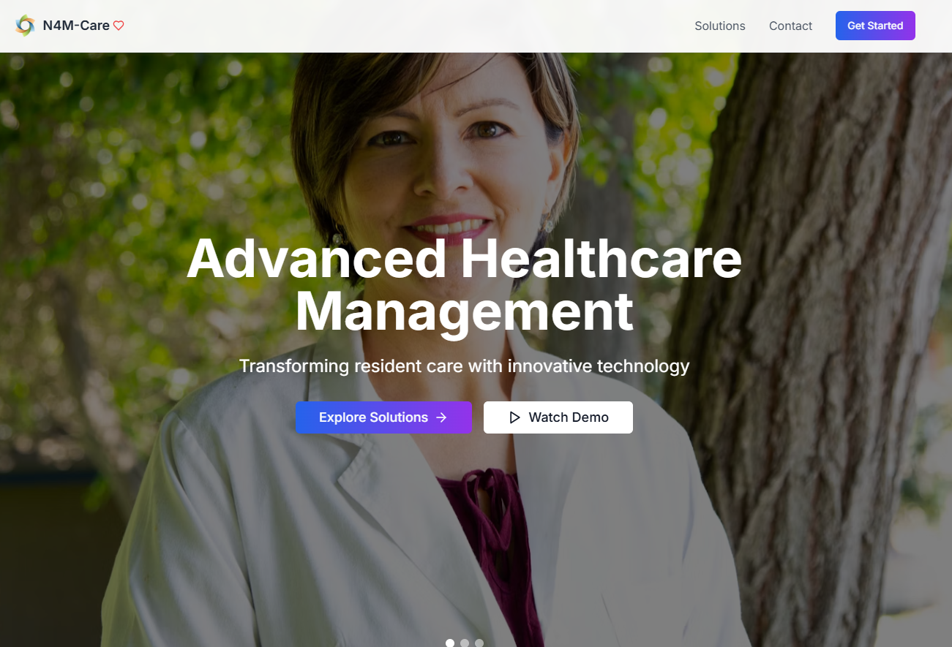
AI-Powered Elderly Care
Trusted, human-aligned automation for modern caregiving.
We transform daily care operations into intelligent, transparent workflows that amplify—not replace—the human touch.
Hackathon Team 6:
Parag Doshi
Shaurya Sundaram
Chaitanya Innamuri
Srinivasan Murali
Corinthian Carpenter
Niranjan Singh
Notes:
On behalf of Hackathon Team: That’s me Parag, Sharya, Chaitanya, Srinivasan, Murali, and Niranjan
We are thrilled to share our AI solutions implanted within the context of a real-world application for Elderly Care.
In this era, where people are fearful of AI, healthcare is certainly an area of dire need of productivity improvements that everyone agrees with.
Our demo is to apply a revolutionary, multi-modal capability to perform cursory diagnosis and care in no time. WE call it “Camera-the-Care”
And beyond using the new AI tech we learned, we managed to tie our feature into a real-world product for Elderly Care

Slide 2
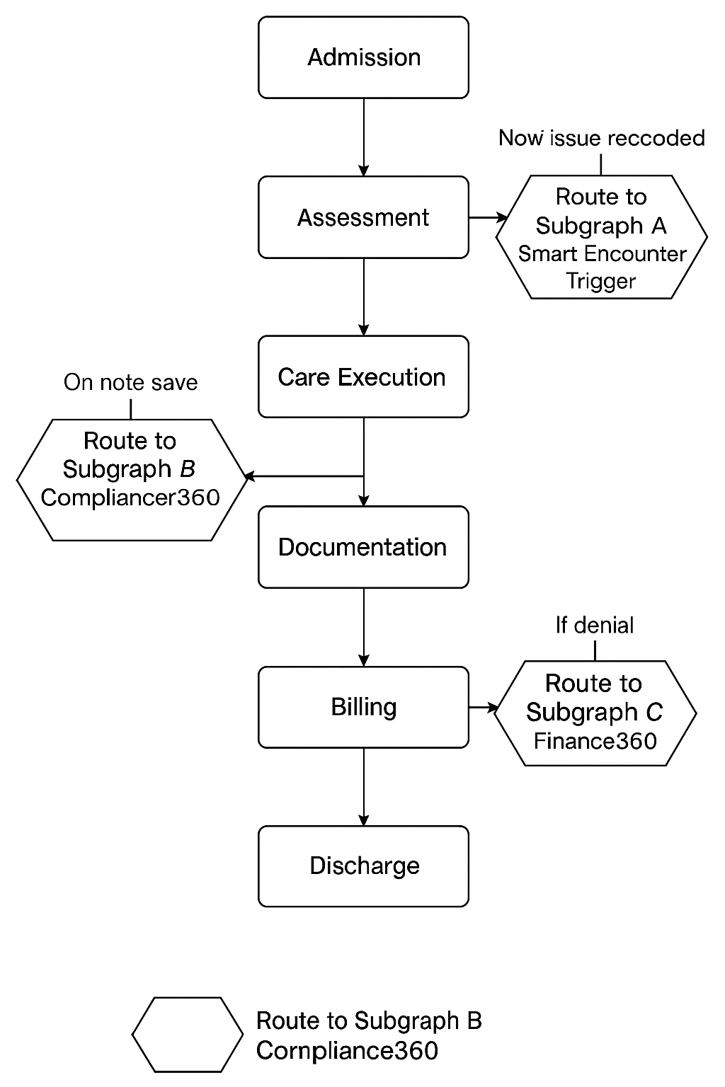
Managing Elderly Care from Admission to Discharge — The Longitudinal Care Story
Demo Scope
“Camera-to-Care”
For the Hackathon we only completed the top right use case: “Camera-to-Care”
Notes:
Hello

Slide 3
Subgraph A Smart Encounter Trigger — “Camera-to-Care”
Image from Phone
Future: Add voice (e.g. WhisprFlow)
Diagnosis Agent (initial)
Injury Classifier
The big idea:
When a caregiver or resident records or photographs a resident encounter (e.g., wound, swelling, rash) via mobile, the image triggers a LangGraph pipeline that:
analyzes the visual cue (captures image)
identifies clinical need (diagnose severity)
Matches care by finding the correct caregiver (based on diagnosis, caregiver skills, positive feedback history)
populates CPT/ICD codes (ensuring compliance and fewer human errors with missing information)
prepares the encounter note (aka electronic verification & validation, required for all care)
LangGraph flow: Input node = Image analysis agent → Condition classifier → Visit scheduler → Documentation agent → Billing compliance node.
Multimodal & autonomous & Comprehensive
“From phone camera to coded clinical encounter” – multimodal
High impact & relevant business need today: care actions in a compliant, traceable chain.
Not just a WebMD (diagnosis and advice) but rather coordinating care with optimized providers (severity, provider skills, latency, location - telehealth)
Insurance Verify
Eligibility & EOBs
Matching Criteria: Proximity, Skills, Feedback Patient history
Assign Caregiver
Caregiver Matcher
Care Event Log
Search Provider MCP
Discover Services, Skills, Ratings, & Proximity
Low Severity
Proximity
High Severity
Instant Care Provided
Google Maps MCP
Caregiver Profiles
Physician Providers
Care Event Log
Notes:
Flow:
Upload – image
Classify – type of injury; severity
Payer Check
Read resident profile to understand insurance eligibility
Read PDF for Payer and check terms, copay, etc. (e.g., will pay 80%, not covered)
We can simulate an MCP that exposes eligibility document, generate an EOB
Caregiver matching (criteria: caregiver skills, proximity, feedback rating)
Read caregiver profile to get skills
Proximity Score, use MCP to measure distance to care:
Search location of caregiver
Search resident’s address at the facility
Feedback Score:
Search feedback from resident
Calendar Score:
Read caregiver availability (search calendar)
Use MCP of our own app to expose the caregivers calendar
Schedule visit
Create stub for the visit
Utilize correct procedure code
Add Compliance Checker:
Audits the stub and full visit documentation
Finds audit issues
Auto-corrects (loop to fix the stub/details)

Slide 4
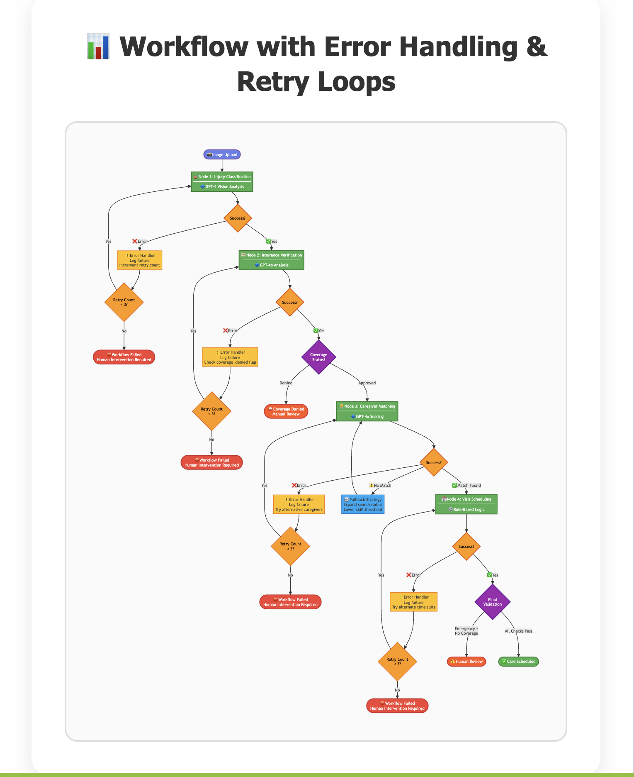
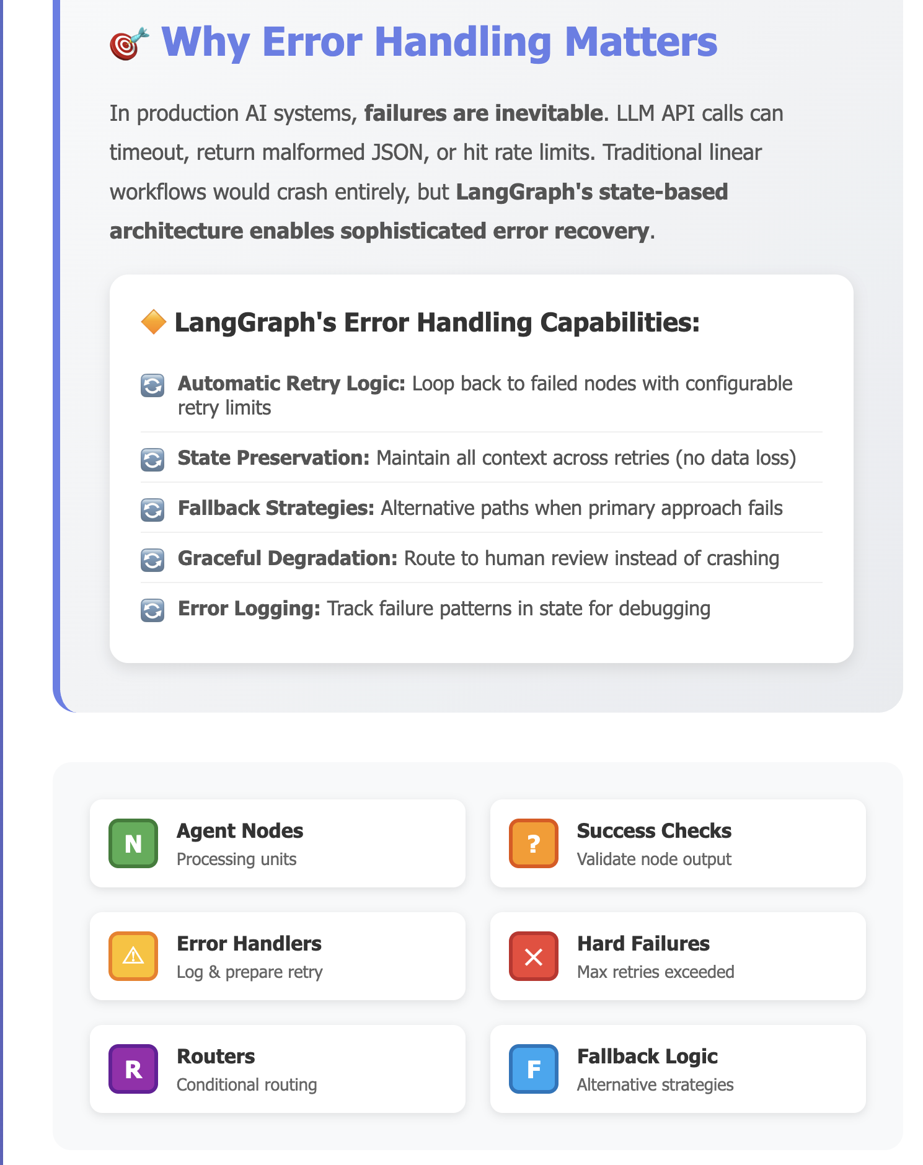
Switch to Live Demo

Slide 5
From Camera to Care to Compliance to Audit Readiness Goals: Instant care & unmatched Medicaid compliance with the new “Big Beautiful Bill”
Image from Phone
Future: Add voice (e.g. WhisprFlow)
Plan: Multi-agent system after all 3 use cases built
Diagnosis Agent (initial)
Compliance Agent
Injury Classifier
Claims & Denials Agent (time-permitting)
Check Incident Record
Eligibility & EOBs
Insurance Verify
Matching Criteria: Proximity, Skills, Feedback Patient history
Read Incidents
List of findings/errors
Assign Caregiver
Caregiver Matcher
AutoFix
File Claim
Discover Services, Skills, & Proximity
Search Provider MCP
Yes
Low Severity
Reimbursed?
No
No
Proximity
High Severity
Yes
Instant Care Provided
Google Maps MCP
Draft Appeal with evidence
Reconcile Acct
Fix Record
Caregiver Profiles
Physician Providers
Close Record
Care Event Log
Accounts Receivable System Center

Slide 6
Appendix

Slide 7
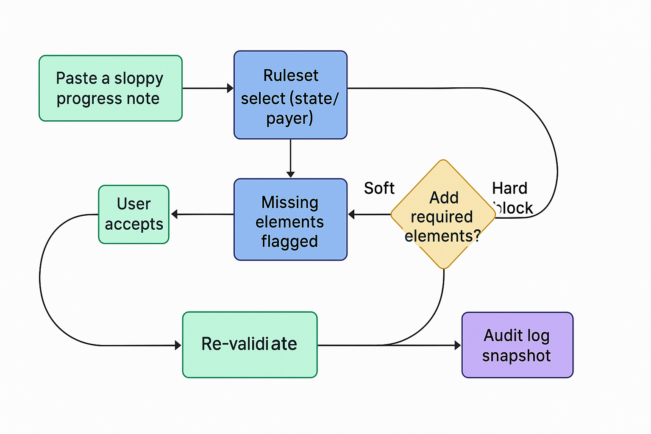
Subgraph B Compliance360 Guardian (Responsibility Cycle)— Virtual Compliance Officer
The big idea:
Every caregiver note and billing event passes through a LangGraph pipeline that validates documentation against policy, procedure codes, and fraud-prevention rules.
LangGraph flow:
Care Note → NLP Compliance Validator → Code Mapper → Audit Logger → Escalation Node if violation.
Full explainability
Real-world responsible AI – Establish Trust with audit & human-in-the-loop
Economically sound – Lost revenue and penalties avoided
Uses LangGraph to represent a “transparent compliance brain”

Slide 8
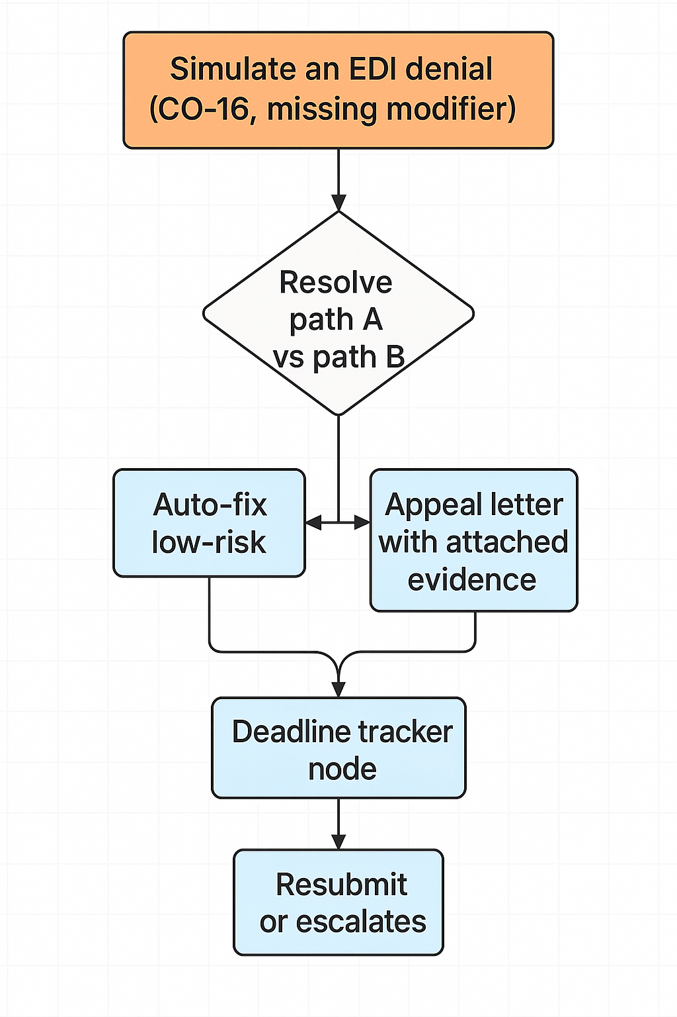
Subgraph C (time-permitting) Finance360 Guardian (Fiscal/Claims Cycle)— Virtual CFO
The big idea:
Facilities lose enormous revenue opportunity and face stiff fines and penalties with Medicaid and Medicare claims processing and lengthy processes for appeals.
LangGraph flow:
Claims → Denial → Fix → Resubmit → Appeal
Full traceability & efficiency
Textbook use case for LangGraph claims and denials
Verbose: Every step visible
Efficient missing element checking and compliance hygiene enforced before lengthy appeals process

Slide 9
AI-Powered Elder Care
Turning everyday caregiver actions into intelligent, explainable workflows. With LangGraph, routine encounters, documentation, and billing evolve into autonomous, cyclic systems that think, act, and learn alongside humans to deliver safer, smarter care.
While we advance the progress of AI, it is essential that we do not lose touch with humanity especially as we enter the golden years of our life.
N4M-Care brings LangGraph’s agent-orchestrated reasoning into the world of elder and facility-based care—where every decision, from wound photos to billing compliance, carries clinical, operational, and ethical weight. Our three graph modules demonstrate how AI can operate safely and autonomously inside healthcare workflows: Smart Encounter Trigger converts a simple phone capture into a full clinical encounter through classification, triage, payer logic, and re-check loops; Compliance360 transforms raw caregiver notes into compliant, audit-ready documentation via dynamic rule-driven branches; and Finance360 closes the loop on revenue integrity, cycling denials and appeals through explainable decision edges. Each module runs as a cyclical LangGraph—branching, learning, and re-entering—showing how explainable autonomy can augment caregivers rather than replace them. The result: a transparent, continuously reasoning system that helps humans deliver exceptional care.
This is a good candidate to showcase intelligent automation in healthcare operations.

Slide 10
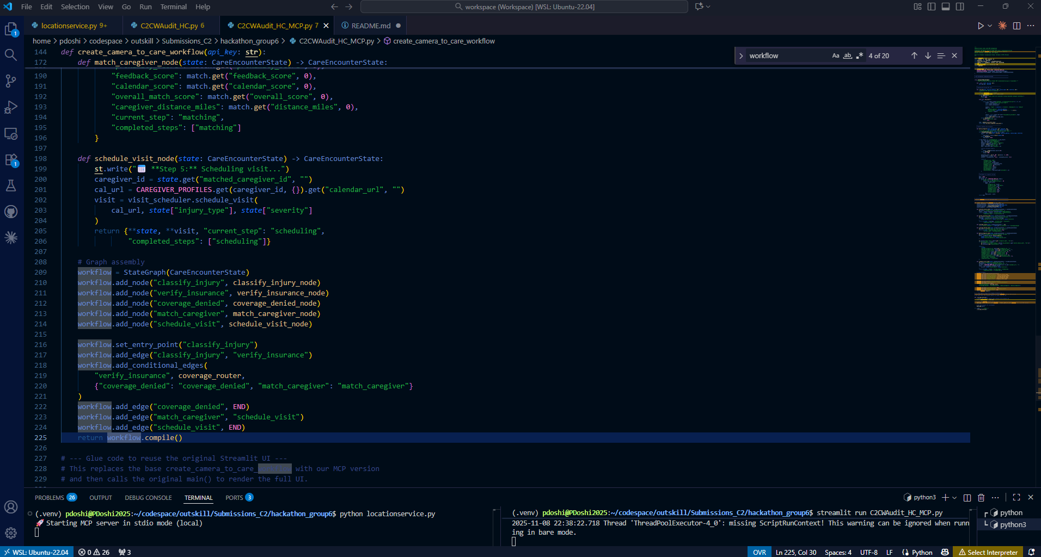
MCP Server & App Running Successfully
MCP TEST RESULT SUMMARY================================================================================✅ Status: PASSED📊 Found: 2 real provider(s)Providers Found:--------------------------------------------------------------------------------1. UCHealth Emergency Care – Broomfield Hospital Address: 1 Descombes Dr, Broomfield, CO 80020 Distance: 1.12 miles Travel Time: 2 minutes Rating: 3.5/5.0 Skills: 24/7 emergency care, minor to life-threatening injuries, board-certified emergency physicians, access to Level 1 trauma center, emergency medical services2. NextCare Urgent Care - 121st Address: 4590 West 121st Avenue, Broomfield, CO 80020 Distance: 0.59 miles Travel Time: 1 minutes Rating: 3.5/5.0 Skills: urgent care services, illness and injury treatment, COVID-19 testing, X-rays🎯 RECOMMENDATION (Emergency - High Urgency):-------------------------------------------------------------------------------- Name: NextCare Urgent Care - 121st Address: 4590 West 121st Avenue, Broomfield, CO 80020 Distance: 0.59 miles Travel Time: 1 minutes Rating: 3.5/5.0 Skills: urgent care services, illness and injury treatment, COVID-19 testing, X-rays ⚠️ EMERGENCY SITUATION: Multiple bone fractures ✅ Recommended: Closest provider (high urgency)📊 METADATA:-------------------------------------------------------------------------------- Urgency: high (Emergency) Service Type: Emergency Care Patient Address: 12510 wolff st, Broomfield, co, 80020 Search Radius Used: 10 miles Max Distance: 1.12 miles Total Found: 2================================================================================TEST COMPLETE================================================================================

Slide 11
From Camera to Care to Compliance to Audit Readiness Goals: Instant care & unmatched Medicaid compliance with the new “Big Beautiful Bill”
Image from Phone
Future: Add voice (e.g. WhisprFlow)
Diagnosis Agent (initial)
Compliance Agent
Google Maps
Injury Classifier
Insurance MCP
Claims Agent (time-permitting)
Check Incident Record
Google Maps MCP
Insurance Verify
Assign Caregiver
Read Incidents
List of findings/errors
Caregiver Matcher
Matching Criteria: Proximity, Skills, Feedback Patient history
Caregiver RAG
File Claim
AutoFix
Yes
Close Record & badge it
Draft Apeal
2nd opinion?
Reimbursed?
No
No
No
Yes
Yes
Running Late (Hold appointment)
Instant Care
Schedule Visit
Reconcile Acct
Fix Record
Refuse or Confirm Appointment
Notify Center
MCP Server
Request 3 slots
MCP Server
MCP Servers
Physician Providers
Discover Services & Real-time Availability

Slide 12
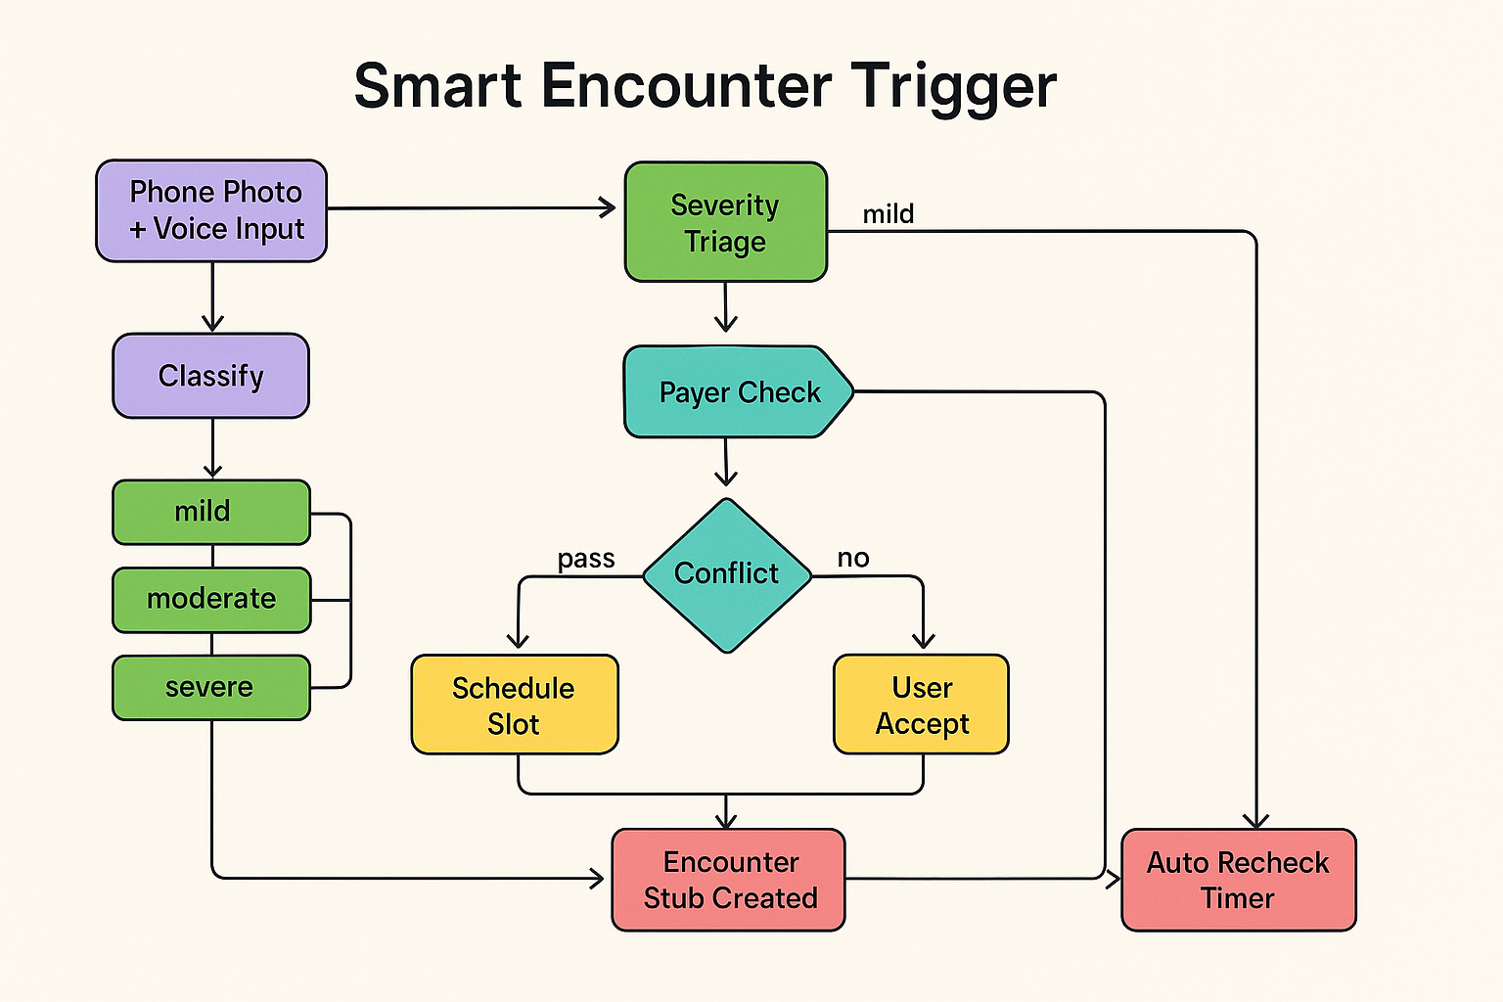
Subgraph A Smart Encounter Trigger — “Camera-to-Care”
The big idea:
When a caregiver or resident records or photographs a resident encounter (e.g., wound, swelling, rash) via mobile, the image triggers a LangGraph pipeline that:
analyzes the visual cue (captures image)
identifies clinical need (diagnose severity)
books visit with the correct caregiver (based diagnosis, caregiver skills, positive feedback history)
populates CPT/ICD codes (ensuring compliance and fewer human errors with missing information)
prepares the encounter note (aka electronic verification & validation, required for all care)
LangGraph flow: Input node = Image analysis agent → Condition classifier → Visit scheduler → Documentation agent → Billing compliance node.
Multimodal & autonomous & Comprehensive
“From phone camera to coded clinical encounter” – multimodal
High impact & relevant business need today: care actions in a compliant, traceable chain.
Not just a WebMD (diagnosis and advice) but rather coordinating care with optimized providers (severity, provider skills, latency, location - telehealth)
Notes:
Flow:
Upload – image
Classify – type of injury; severity
Payer Check
Read resident profile to understand insurance eligibility
Read PDF for Payer and check terms, copay, etc. (e.g., will pay 80%, not covered)
We can simulate an MCP that exposes eligibility document, generate an EOB
Caregiver matching (criteria: caregiver skills, proximity, feedback rating)
Read caregiver profile to get skills
Proximity Score, use MCP to measure distance to care:
Search location of caregiver
Search resident’s address at the facility
Feedback Score:
Search feedback from resident
Calendar Score:
Read caregiver availability (search calendar)
Use MCP of our own app to expose the caregivers calendar
Schedule visit
Create stub for the visit
Utilize correct procedure code
Add Compliance Checker:
Audits the stub and full visit documentation
Finds audit issues
Auto-corrects (loop to fix the stub/details)

